Slide 1
Hadoop and Yarn
Md Sahil Priyank Lohariwal
0017010501029 001710501055
Department of Computer Science and Engineering
Jadavpur University

Slide 2
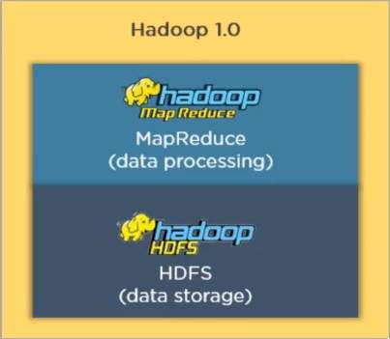
Hadoop 1.x
HDFS
MapReduce

Slide 3
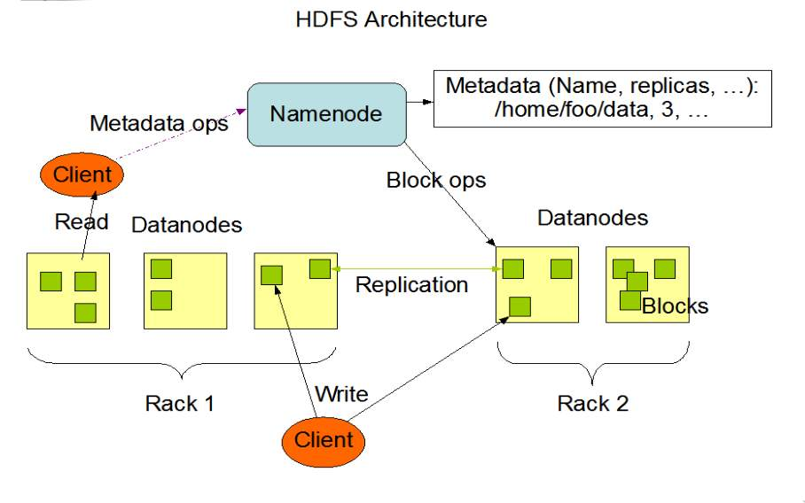
HDFS

Slide 4
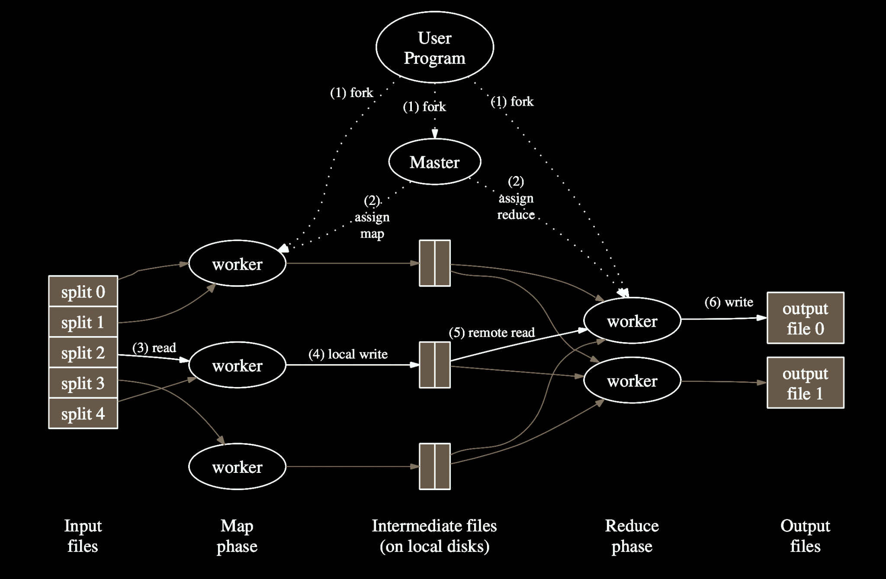
MapReduce

Slide 5
Allocated resources, scheduling
Job Tracker

Slide 6
Hadoop Master Daemon
Client 1
Job Tracker
Client 2

Slide 7
Client 1
Job Tracker
Client 2

Slide 8
Task Tracker
Task
Task
Client 1
Job Tracker
Task Tracker
Task
Task
Client 2
Task Tracker
Task
Task

Slide 9
Limitations of Hadoop 1
Scalability
Availability
Resource Utilization
Limited Programming models

Slide 10
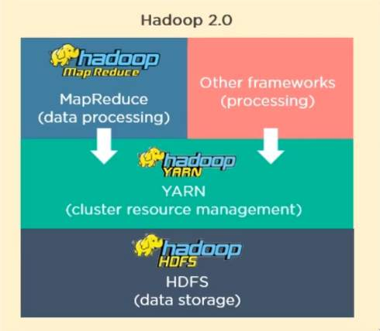
Hadoop 2.X

Slide 11
HDFS v2
Master-Slave Architecture
NameNode
DataNode
Secondary NameNode
Stand by NameNode
Federation
Heartbeats

Slide 12
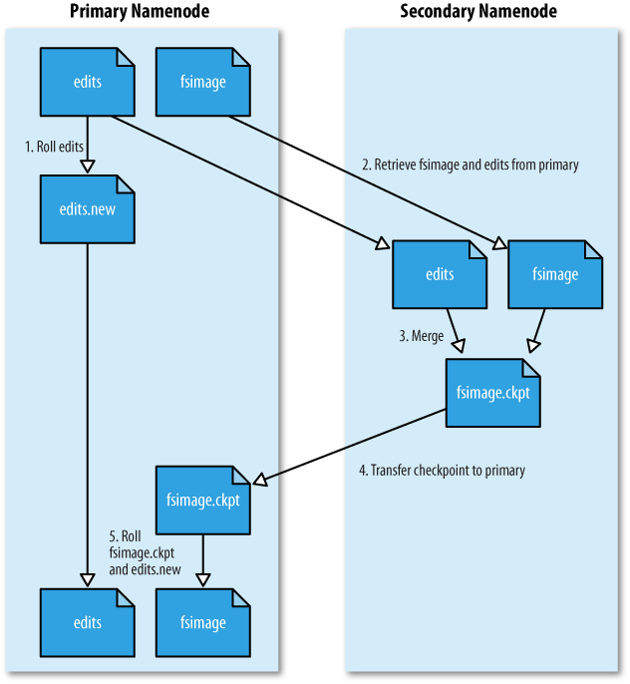
HDFS v2
Secondary NameNode

Slide 13
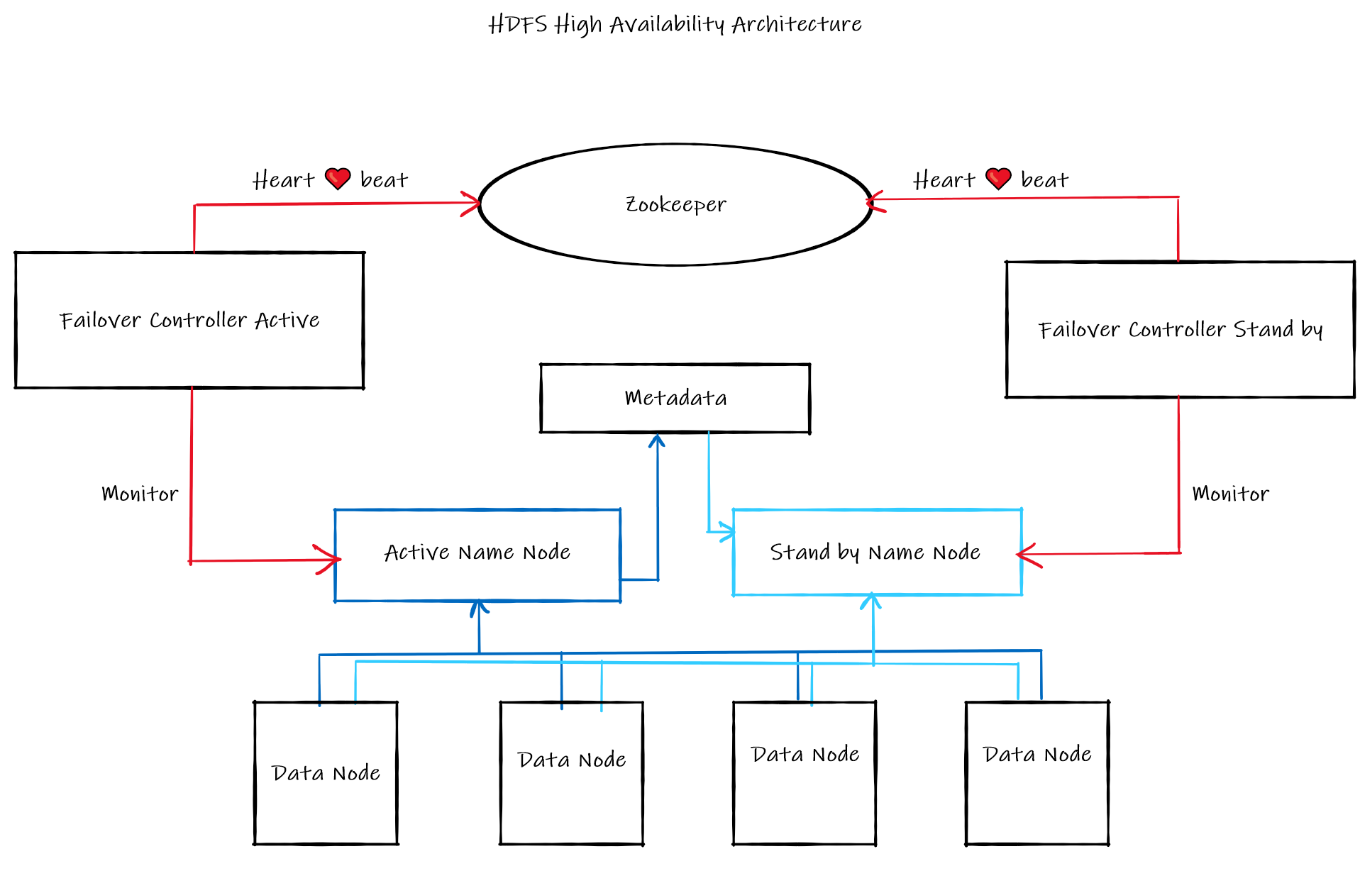
HDFS v2
Stand by NameNode - High Availability

Slide 14
HDFS v2
Federation
NameNode 1
NameNode 2
NameNode 3
Namespace 1
Namespace 2
Namespace 3
Data Node
Data Node
Data Node
Data Node

Slide 15
HDFS v2
Heartbeats
Total Storage
Used Storage
Activity
NameNode
(Metadata storage)
Heartbeats
Data Node
Data Node
Data Node

Slide 16
Yet Another Resource Negotiator
Resource management
Job Scheduling

Slide 17
Resource Manager
Scheduler
Application manager

Slide 18
Client 1
Resource Manager
Scheduler
Application manager
Client 2

Slide 19
Node
Client 1
Node
Resource Manager
Scheduler
Application manager
Client 2
Node

Slide 20
Node
Node manager
Client 1
Node
Resource Manager
Node manager
Scheduler
Application manager
Client 2
Node
Node manager

Slide 21
Node
Node manager
App Master
Client 1
Node
Resource Manager
Node manager
Scheduler
Application manager
App Master
Client 2
Node
Node manager

Slide 22
Node
Node manager
App Master
container
Client 1
Node
Resource Manager
Node manager
Scheduler
Application manager
container
App Master
Client 2
Node
Node manager
container
container

Slide 23
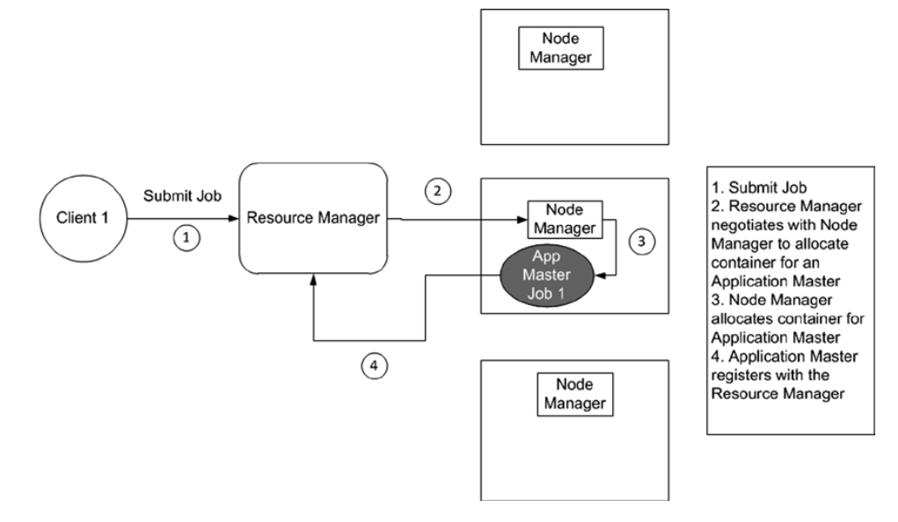
Application master startup

Slide 24
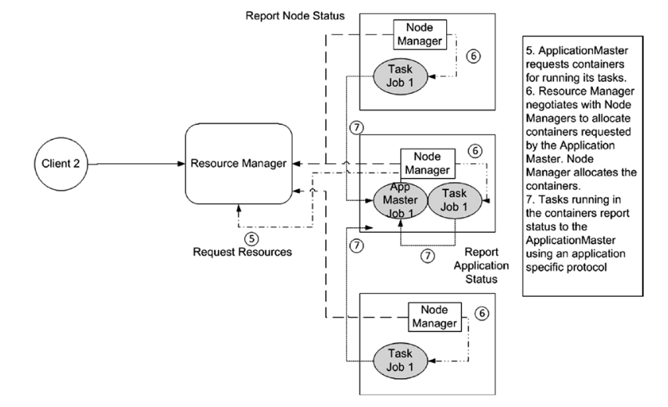
Job resource allocation execution

Slide 25
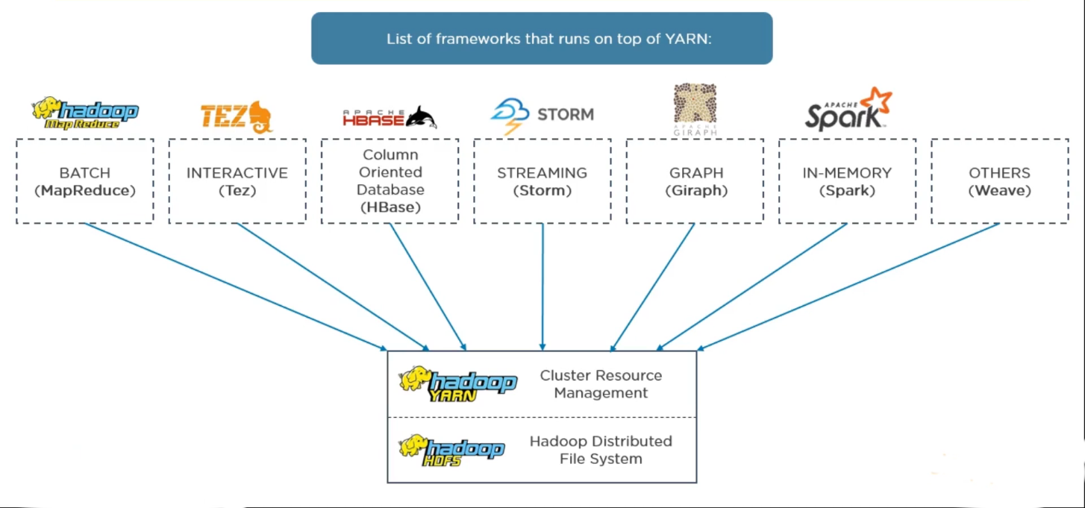

Slide 26
Hadoop 2.x over Hadoop 1.x
Fault tolerance and Failure recovery
Multiple namespaces
Scalability: 10,000 nodes per cluster
Resource Utilization
Multiple Programming Models

Slide 27
Future of Hadoop

Slide 28
Future of Hadoop
Hadoop 3.x
JournalNodes
Erasure coding for data replication
Intra-datanode data balancer
Support for multiple file systems
Support for opportunistic containers and distributed scheduling

Slide 29
Thank You

